Slide 1
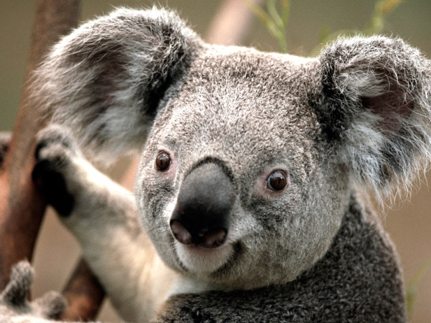
DAILY DIABETES CARE
For (Childs Name)
The daily aim: To keep Nika’s blood sugar/glucose (BG) as normal as possible. Normal = anything from 5 to 10 on the test meter. Remember to scan every 2/3 hours depending on her levels.
How do you do keep the BG as normal as possible?
Watch daily for signs of low or high blood sugar (see pg. 3) and know how to treat them (pg. 4). Know how to test Nika’s sugar (pg. 2).
Know the sick day protocol: if Nika’s has a temperature, please call me asap. Fever causes ketones, which can be bad.
Know the emergency procedure (see pg 5) - if BG is 3.0 or below, or the word “LOW” appears on the meter, immediately follow emergency procedure.
What can make blood glucose go too low?
A lot of exercise without a snack to offset the dip
Not eating his snack mid-morning
Upset tummy
What can make blood glucose to go too high?
Lots of exercise when blood glucose is already high
Fever/getting sick (Beware of Ketones – see page 4)
Anxiety or stress; adrenalin
Mom:
Dad:
DOCTOR’S 24-HOUR EMERGENCY
(Doctors Name)
Medical Info: (Details)
Membership: (Details)
Page 1

Slide 2

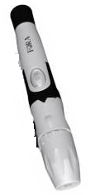
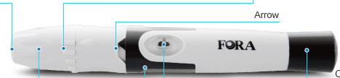

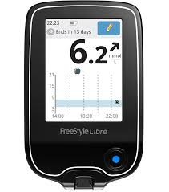

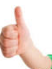
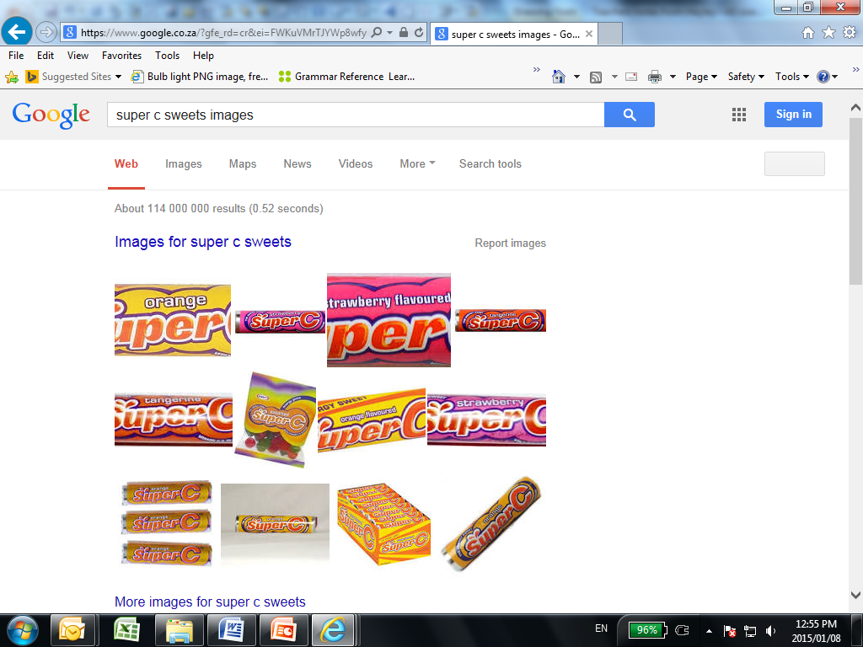
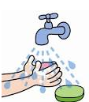
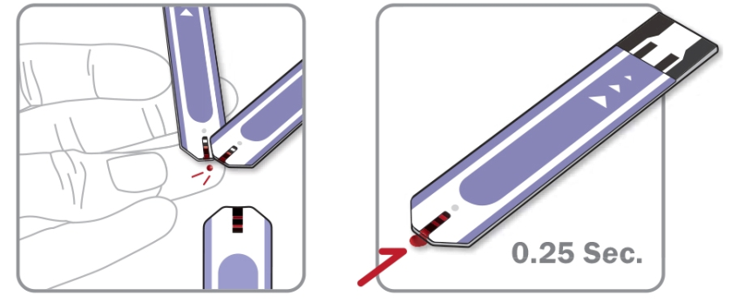
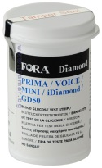

5. Pick up the finger-pricking device.
Pull the back black cap until it clicks. The button will turn orange. It is now loaded.
HOW TO TEST BLOOD GLUCOSE
Very important: unless sugar is very low, insulin for snacks must be given 10 to 15 minutes before snacks are eaten, so that the insulin has time to become active first – this will only depend on his BG levels. First contact ME via Whatapp with his levels readings.
Normally NO need to inject before lunchbox
Pull-cap
Finger-pricking device
Goes orange. Trigger
THE KIT
Meter
6. Place the opposite end (white) on Nika finger and push the trigger button on the side of the pen.
Side to put on fingertip
Blood glucose (BG) test strips (in bottle)
7. Transfer the drop of blood onto the strip in the meter and wait 5 seconds for the reading to appear.
Glucose sweets
2. Wash & dry your and Nika’s hands (any trace of food on hands can cause incorrect reading)
3. Take a test strip out of the black bag & insert it into the meter, striped side first.
4. See an image of a drop of blood appear on the meter screen. The meter is now ready for use.
Page 2

Slide 3
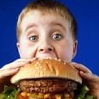
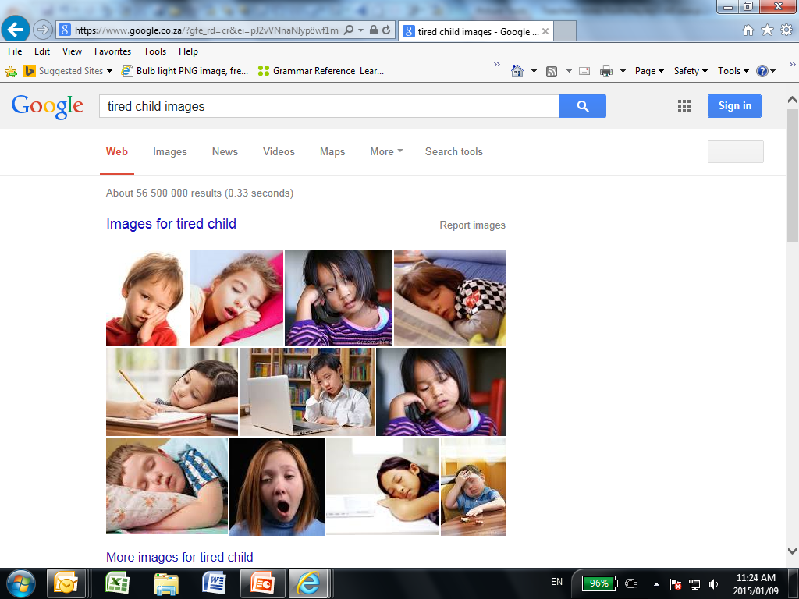
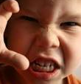
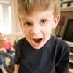
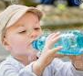
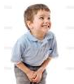
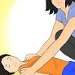
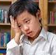
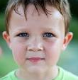
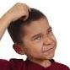
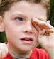
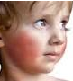
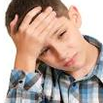
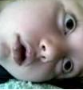
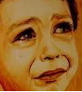
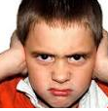
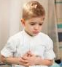
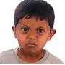

SIGNS THAT NIKA’S BLOOD SUGAR COULD BE LOW
(HIPO)
SIGNS THAT NIKA’S BLOOD SUGAR COULD BE HIGH (DKA)
LOW (3 TO 3.9 mmol)
VERY LOW (2 TO 3 mmol)
SEVERE LOW (1.9 or below, or “LO”)
HIGH BG (reading of 13 and above)
Hungry
Tired/weak
Aggressive
Restless
Thirsty
Tired/
lethargic
Urinates more often
Unconscious
Pale/dizzy
Shaky/
sweaty
Confused
Blurred
Vision or very, very sleepy: wanting to sleep
Blurred
vision
Warm/
flushed
Headache
Seizure
EMERGENCY TREATMENT:
PAGE 5
Headache
Emotional/
teary/ anxious
Aggressive
Frustrated
Stomach
ache (test for Ketones)
These 4 signs of a low can also be symptoms of HIGH blood sugar.
Nika is a happy child. If he fights with another child or is weepy, it’s a sign he could have high sugar. He also looses control of his bladder so accidents may happen sometimes
Irritable
Stomach
ache/nausea
See below for treatment.
Page 3

Slide 4
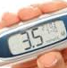
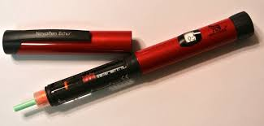
TREATING LOWS - please call me:
(Cell Number)
TREATING HIGHS (i.e. BG OVER 15)
LOW TO VERY LOW
(BG between 2 and 4)
SEVERE LOW
1.9 or below, ‘LO’ on meter
Wash Nika’s and your hands with soap and water and dry well (Alcohol Swipe)
Please WhatsApp us with reading straight away and I will advise.
After chatting to us , give Nika a correction if necessary, as follows:
Load the amount of units needed on insulin pen. Most of the time it will always be
RED PEN – 0.5 – 1.0 unit
Remove cap
Face the pen upwards and “Dial” 3 units and press the back of the pen so the
Insulin can squirt up in the air (clears bubbles). Then dial 0.5 – 1.0 PLEASE MAKE SURE that its according to pro-call!
Injection in upper are or upper thigh or stomach by pushing back of pen down. Hold for 15 seconds.
PLEASE ALWAYS GIVE NIKA WATER
HE will then need to wee a lot, and this will help flush some of the sugar out.
KETONES: If BG is high (anything over 18) and Nika seems moody, you may need to test Ketones -these are toxins that develop in the blood when BG is very high. They can make Nika feel nauseas and angry, and, if sugar remains high, could lead to Ketoacidosis, a very serious condition. Must be treated straight away.
Please call me I will fetch Nika immediately.
BLOOD SUGAR BETWEEN 2 AND 3.5 – please give three Super Cs or
Three DexD Tablets or tub yogurt or DexD GEL
BLOOD SUGAR BETWEEN 3.6 and 4.4 – please give Nika n two Super Cs or
Two DexD Tablets .
BLOOD SUGAR BETWEEN 4.4 AND 4.9 – one Super C/DexD Tablet
.
*****
THIS IS AN EMERGENCY.
*****
PLEASE FOLLOW TREATMENT STEPS ON
PG 5.
Liquid options: fruit juice 100ml / halwe glas coke
Please don’t over-treat, or blood sugar will go too high.
15 min. after treatment, please test or check blood glucose again and Whatsapp me with the result, so that I can guide you as to whether further treatment is needed. Thanks so much.
Page 4

Slide 5
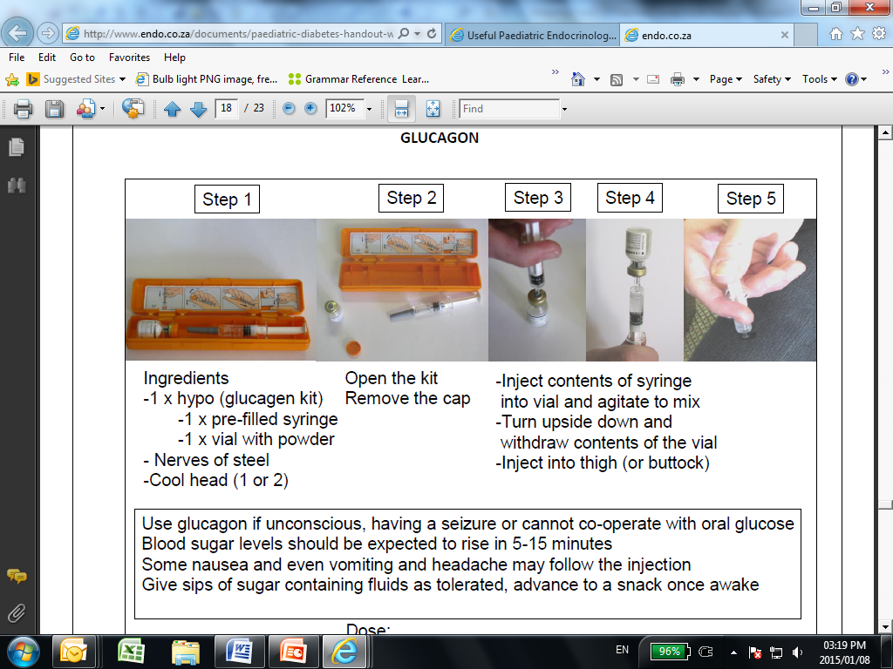
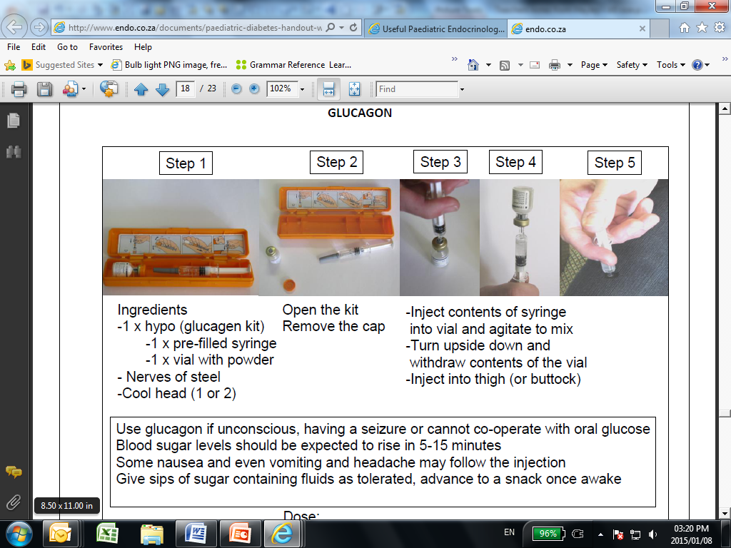
SEVERE LOW: EMERGENCY PROCEDURE
(Meter says “LOW” or ‘1.9’ or below and NIKA is falling asleep or unconscious, ALWAYS TEST THE BLOOD
EMERGENCY PROCEDURE:
ADMINISTERING THE GLUCAGON INJECTION
Please ask someone to call me or (Doctor Name) while you start treatment. See pg 1 or Nika’s medic alert bracelet for telephone numbers.
IF NIKA CAN SWALLOW:
Immediately give her one of the liquid glucose options listed on pg 4 (Regular Coke, etc). He should sit quietly, not run around or play.
Watch for recovery within 5 mins. Test blood glucose (BG) after 15 mins.
2. IF NO RECOVERY YET, OR IF NIKA CAN’T SWALLOW:
Rub condensed milk, syrup, honey or glucose syrup (the latter is in Nika’s emergency bag) onto gums.
Watch for recovery and test BG within 15 minutes.
3. IF NO RECOVERY YET, OR NIKA IS UNCONSCIOUSNESS OR HAS A SEIZURE:
Call me or Dr WILLIE and the ambulance immediately for on-the-phone guidance. You must immediately administer half the dose of the emergency Glucagon injection, kept in an orange box in her coolerbag in the fridge. See right for administering directions. The injection contains pure glucose which helps a child who can’t swallow glucose to regain consciousness quickly. (PS. We’ve never yet had to use the Glucagon ☺)
4. RECOVERY SHOULD TAKE 5 TO 10 MINS. Nika may vomit.
Test BG after 15 mins. As long as the BG remains above 5, Nika can sleep if she needs to. (BG to be checked every 3 hrs for next 6 hrs after a severe episode, but then I will take over
½ of the
Page 5

Slide 6

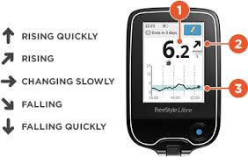
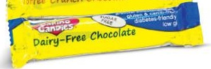
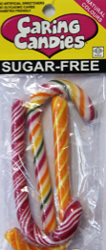

    Reading the Freestyle Libre
    The number on top shows blood glucose level. The arrow sows if its stable/ dropping or going up.
Blood glucose and arrow
    Caring Candies Carb-Free chocolate in the blue and gold wrapper –
    Caring Candies Carb-free boiled sweets/lollies– for treats when
    necessary. Please don’t give more than 2 in a day..
    (laxative properties. ☺)
    Nika may NOT have any carbs. Please don’t give her cake/chips/cookies unless its from his lunchbox or its labeled as Diabetic TYPE 1

Slide 7
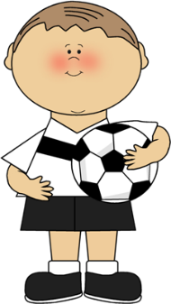
OEFENING
‘n Diabetes Kind kan alles doen
wat ander kinders doen. Hulle kan
Fiets ry en bal skop ☺
Oefening is BAIE belangrik vir diabete. Dit hou hulle sterk en fiks. Belangrikste is dit help om die bloedsuiker reg hou.
Onthou net: daar is drie dinge wat BAIE BELANGRIK is wanneer jy oefeninge doen
TOETS SUIKER :
Moenie oefening doen as die suiker te lag is nie – as dit te laag is volg die noodstappe soos aangedui vir ‘n “LOW” op bladsy 4. Oefen slegs as suiker reg is!
Moenie oefeninge doen as die suiker BAIE hoog is nie (15mmol en hoër), anders word dit net hoër.
2. TERWYL JY OEFEN
Juffrou of Meneer moet altyd
Die scanner & stokkies naby
he as Gordon nie lekker voel nie.
Hy gaan eerste kla van “Kop” Pyn!
BAIE WATER en altyd NOOD
LEKKERNY vir ingeval die suiker
Val moet byderhand wees.
Moet nooit net dalk nog “5 min” wag as hy nie lekker voel nie.
Check erder met prik as julle onseker is.
3. NA DIE TYD TOETS SUIKER
Hy het baie energie gebruik so die suiker kan dalk laag raak,
Eet van die noodkissie as dit laag is soos
Aangedui op bladsy 4 en toets na 15 min weer.
Onthou maak nie saak wat die suiker telling is nie , jy bly altyd n wenner want jy het PROBEER!
Onthou Nika is lewenslustige dogtertnie en dat die diagnose haar nie moet brandmerk nie. Sy sukkel om diagnose te aanvaar!

Slide 8
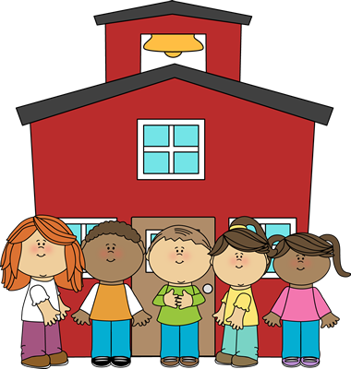
SKOOLRIGLYNE VIR DIE HANTERING VAN ‘N DIABEET
Tipe 1 diabetes veroorsaak flutuasies in die bloedsuikervlakke van die kind.
Beide lae bloedsuiker (Hipoglisemie) en hoë bloedskuier (Hiperglisemie) kan gevaarlik wees as dit nie dadelik en doeltreffend hanteer word nie. Dit kan die kind se vermoë om te leer en te presteer erenstig beinvloed.
Die doel van die riglyne is om die diabeet in die skool ‘n veilige omgewing te skep waar hy/sy tot hul volle potensiaal kan ontwikkel
Riglyne
Belangrik dat maaitjies en ander ouers kennis dra van Diabeet in die skool
Die diabeet moet asb teen alle tye VRYE toegang het tot toilette.
Die diabeet moet teen alle tye toegang het tot water (BOTTEL water in klas is goeie opsie)
Die diabeet moet teen alle tye toegelaat word om peuselhappie te eet indien moontlik en toegang tot sy apperaat (Nika kan nog nie self suiker toets nie, ASB Juffrou)
Wanneer die diabeet se bloedsuiker voor sport/LO te laag of hoog is moet hy asb verskoon word (sien Bladsy 7 – Oefeninge)
Moet altyd persoon op perseel of tydens pouses wees wat weet hoe om diabeet se suiker toe toets.
Snoepie/Klas partyjies moet mamma asb ingelig word vooraf om seker te maak dat die diabeet sy spesiale pakkie kry. (ek sal self pak so die mamma van die verjaarsdag maaitjie moet my asb kontak)
Diabeet (veral omdat hy nog klein is) mag alleen gelos word of gestuur word as die suiker lag is nie. As die suiker te laag is moet iemand hom asb vergesel.
U BEGRIP EN SAMEWERKING IS VIR ONS ONONTBEERLIK – DANKIE ☺

Slide 9

Vir my Juffrou
-1-
Liewe Juffrou
ek is ‘n diabeet,
Juffrou weet mos.
Diabetes is suikersiekte.
Die slim dokters sê
dis nie ‘n siekte nie,
dis ‘n toestand.
Maar weet Juffrou,
Hierdie toestand
Voel partykeer darem baie soos
Siekwees.
Nou wil ek net
Betyds sê, Juffrou:
óf toestand óf siekte,
Diabetes
Is nie vir sissies nie!
Ek het nie diabetes
oor ek te veel suiker
Geëet het nie, Juffrou.
Ek het dit ook nie gesoek nie,
en ek het dit ok nie verdien nie.
Ek het dit omdat Jesus ‘n baie
Spesiale werk vir my het.
Net vir my, en vir hierdie
toestand-siekte van my.
-2-
Juffrou sien, ek is nie
Anders as ander kinders nie, en tog is ek anders.
Ek wil nie spesiale
gunste hê nie, Juffrou,
maar ek kan nie oorleef
sonder Juffrou se begrip nie.
Sekere woorde kry
‘n ekstra betekenis
HOOG is nie net
Daarbo waar die sterre is nie.
LAAG is nie maar net hier onder by my voetjies nie.
HOOG word ‘n aanslag
op my kosbare lewe….
en LAAG word ‘n verskrikking..
die grypende kloue van
‘n koma.
Wéét Juffrou hoe lyk LAAG?
Juffrou dis nie mooi nie!
Dis ‘n saak van histerie …..
en angs…
Dis ‘n saak van koue sweet en spiere wat pluk-pluk….
Dis ‘n saak van bibber
En duisel
Juffrou wil dit nie sien nie ☹
-3-
Dis hoekom ek moet
toets, Juffrou
sal Juffrou my help?
Al is dit tien keer onnodig
Dan ter wille van daardie
Één keer…
En dan moet ek
Iets eet Juffrou
Al is dit nog nie
Eers speeltyd nie.
Ag Juffrou, ek verstáán
Ook jou frustrasie.
Ek wil nie jou les
Onderbreek nie.
Ek wil nie kou as almal
Vir my kyk nie!
Om eerlik te wees, Juffrou
eintlik wil ek
hierdie hele
diabetes-ding
nie hê nie!
-4-
Maar weet Juffrou,
saam met die prikke
op die punte
van my vingers,
saam met die
hoog en die lag
en die spuite
op my maag,
het ook die
aanvaarding gekom…
‘n realisme ver
bo die jare van
my klein lyfie.
En ek is so dankbaar
vir jou Juffrou,
wat verstaan van my
Bittersoet lewe.
Jesus het net geweet
watse spesiale Juffrou
en skool om vir my
uit te kies
Dankie, Juffrou!
Liefde Gordon
Notes:
CHANGE ACCORDING TO YOUR NEEDS

